Slide 2

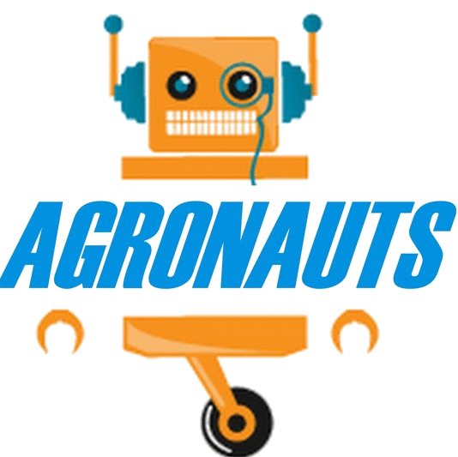
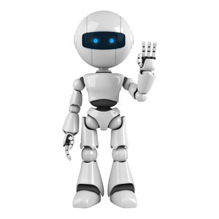

AGRONAU S
The Gen-Next Agriculture
Guidance:-
Prof. Chaiyaporn Mutsalklisana
Teaching Assistant:-
Thiyagarajan Anandan
Data Warriors:-
Nitin Bali
Rutika Ranjolkar
Ramyasri Gujjari
Shramika Jadhav
Vikas Sirwal

Slide 3
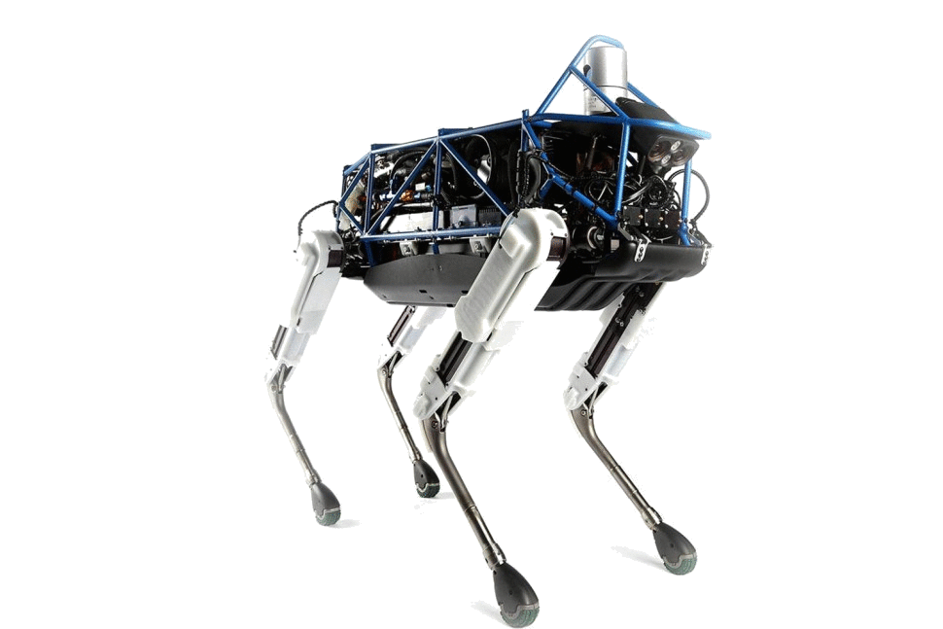
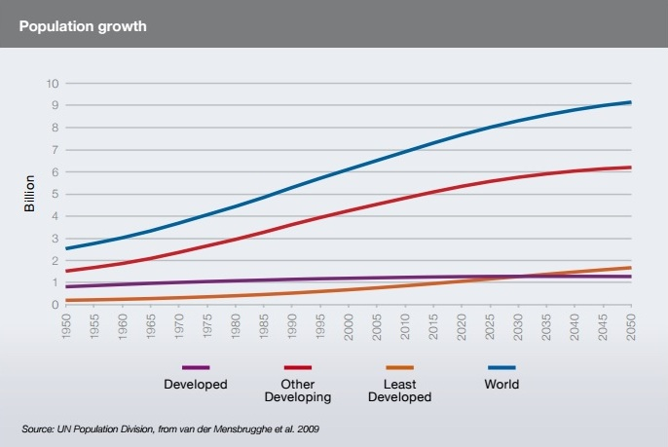
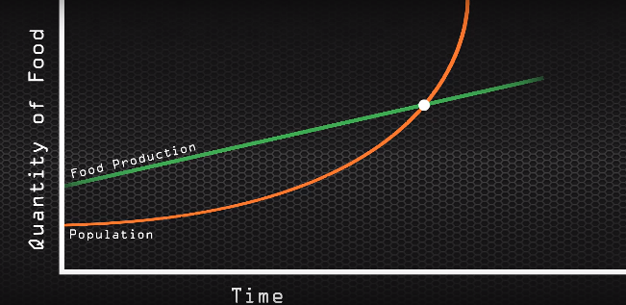
WHAT ?
HOW ?
Projection Says !!
The projections show a raise of 9.1 billion people in world population by 2050 . It would raise an overall food production by some 70 percent between 2005/07 and 2050.
Feeding the World!!
By 2050 we’ll need to feed two billion more people. How can we do that without overwhelming the planet?
Introducing a new Agricultural technique using Artificial Intelligence.
Intelligent robots will perform tasks like planting, tendering and harvesting individually

Slide 4
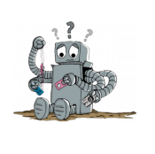
ASSUMPTIONS…
Crop categories are based on season
Length and Width between the seeds is measured in Millimeter.
Agro Admin will be assigned to only one field.
We consider maximum 2 sectors per field.
No watering in Planting Operation
Speed of Moving Devices is measured in meter/second.
Crop categories are based on season
Frequency of water will be with respect to a day (frequency = 2/day)
Temperature will be calculated in degree Celsius.

Slide 5
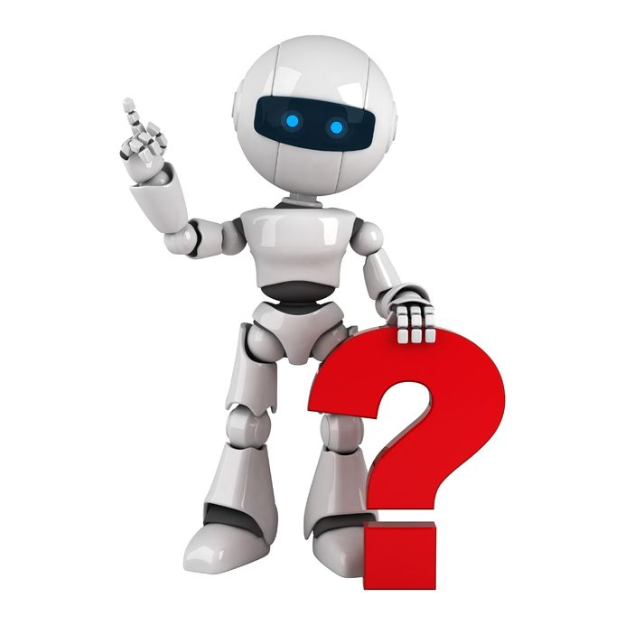
CLOUD
SENDS /RECIEVE CLOUD/FIELD INFO
SENDS SOS MESSAGE IF REQUIRED
SENDS REAL-TIME DATA ABOUT THE FIELD
HOT-SPOT TOWER
Radio Waves
WEB/MOBILE APPLICATION
ZigBee
Microwaves
RECEIVE CLOUD INFO/ SEND FIELD INFO
SENDS / RECIEVES ALL THE DATA
OPERATIONAL
FLOW
RECEIVE CLOUD INFO/ SEND FIELD INFO
FARMER
DATA COLLECTORS
SETS THE PERIMETER OF THE FIELD
DATA COLLECTORS
ROBOTS SEND DATA
ABOUT FIELD WORK
ROBOTS RECIEVE SOS MESSAGES AND WEATHER FEED
ROBOTS SEND DATA ABOUT FIELD WORK
ROBOTS RECIEVE SOS MESSAGES AND WEATHER FEED
EXCHANGE POSITION AND TASK RELATED DATA
EXCHANGE POSITION AND TASK RELATED DATA
AGRONAUT
AGRONAUT
AGRONAUT
AGRONAUT
ROBO-CLUSTER
ROBO-CLUSTER

Slide 6
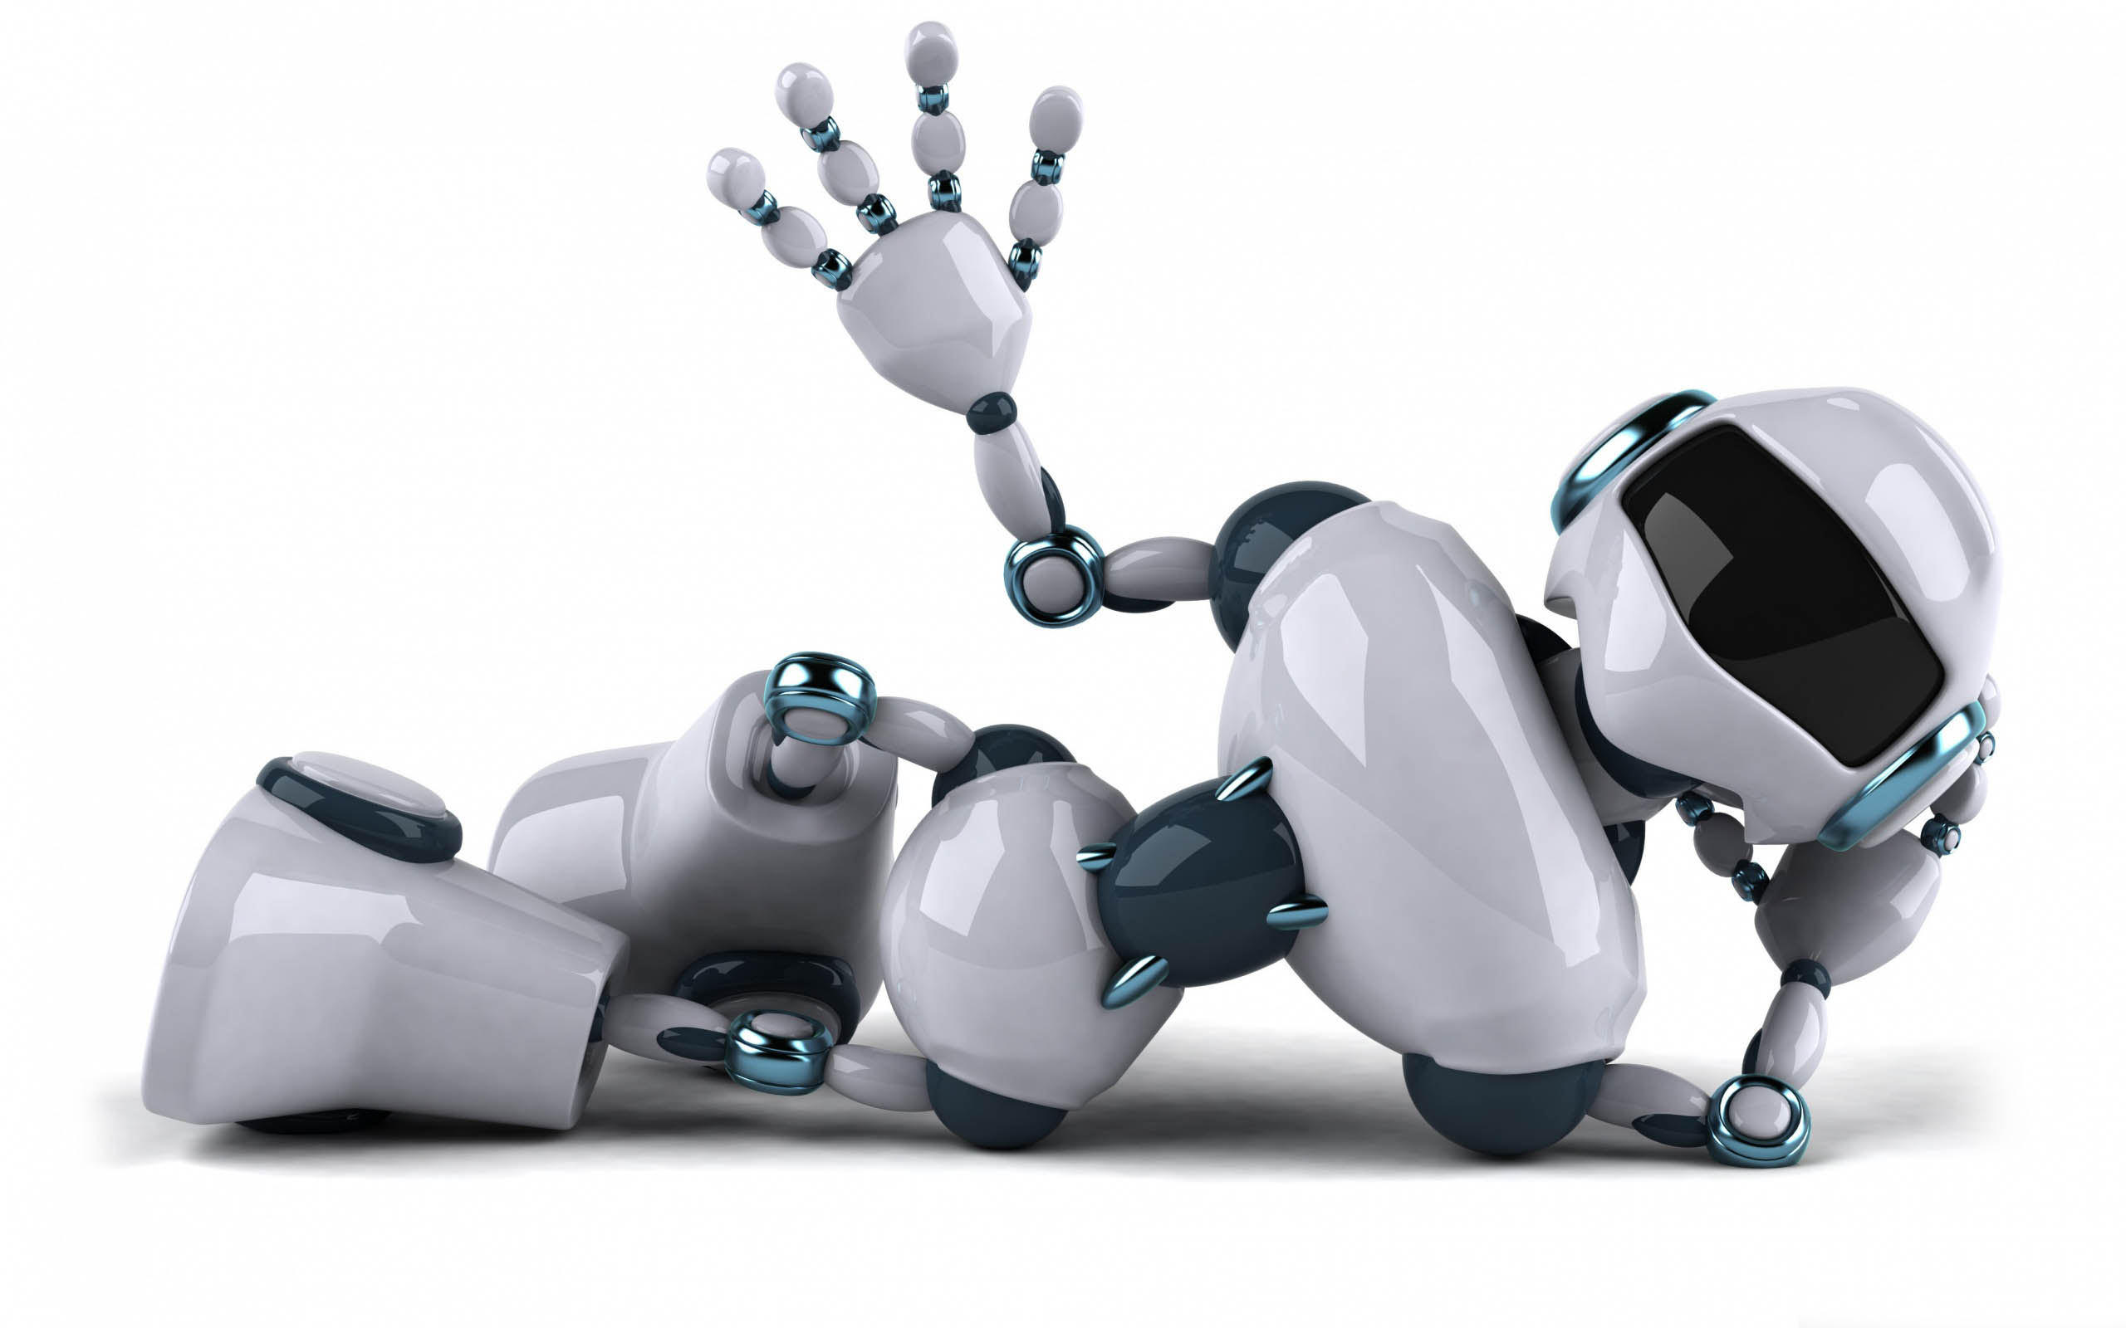
BIRDS EYE VIEW
AGRONAUTS finding paths via Ant Colony Optimization. Planting and Harvesting.
FENCE
Transferring data from/to
collectors and sharing it with
the cloud.
HOTSPOT TOWER
Cloud Data Storage
DATA
TRANSFER
AGRONAUTS
FARMER Supervising the activies via web/mobile application.
Weather channel / Global Information feed for climate updates.
DATA COLLECTORS Receiving and Sending data from/to the Agronauts. Sending data to Tower.

Slide 7
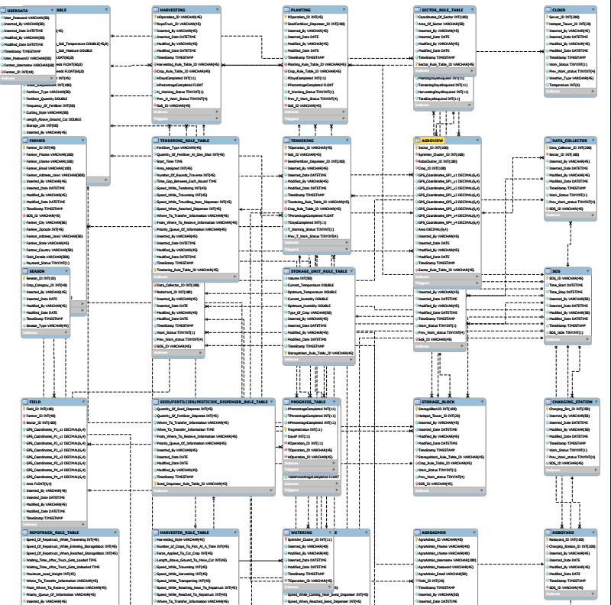
ENTITY RELATIONSHIP DIAGRAM

Slide 8
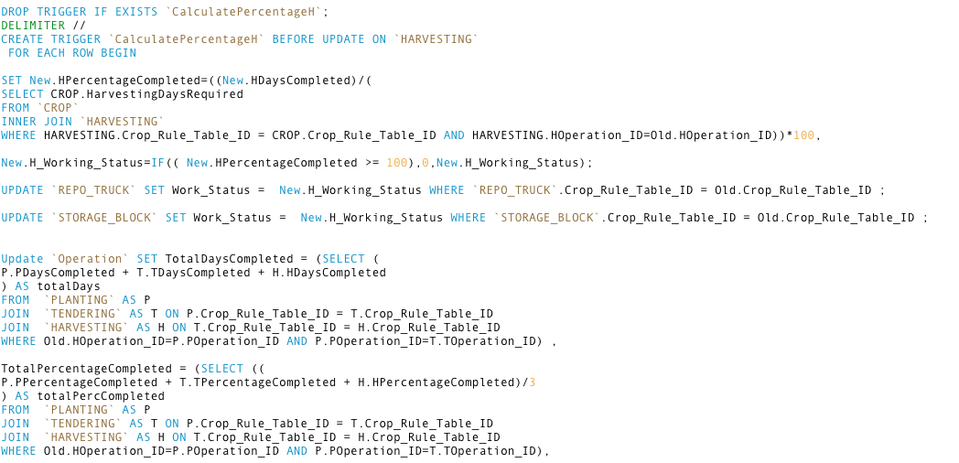
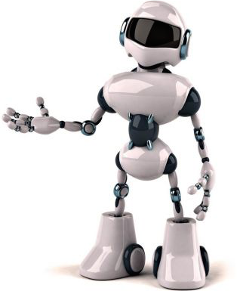
SQL TRIGGERS
These triggers help to calculate certain values like Progress Value of Operations and Percentage Values of Plating, Harvesting and Tendering.

Slide 9
SQL TRIGGERS
These triggers help to shift the operation from Plating to Tendering, and then from Tendering to Harvesting.

Slide 10
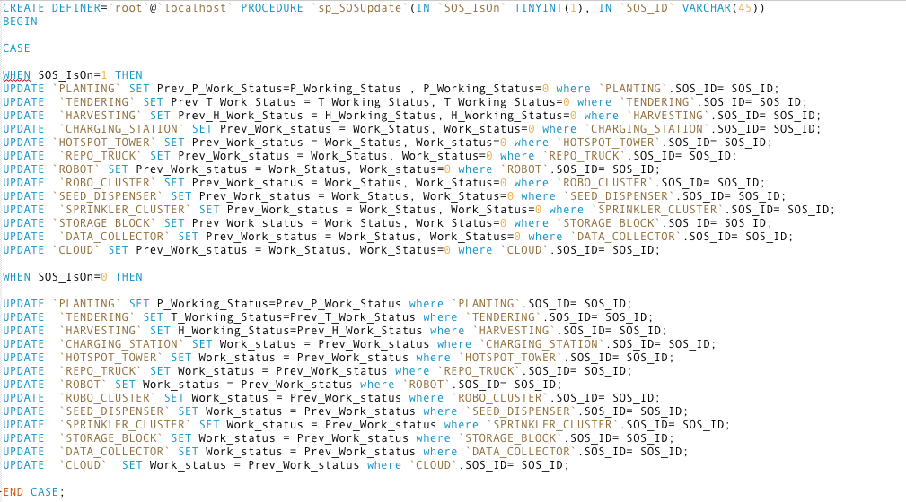
STORED PROCEDURE
We have implemented 2 Stored Procedure. One stored procedure is to turn off all the working entities (SOS). Second SP stores the value from the UI.

Slide 11
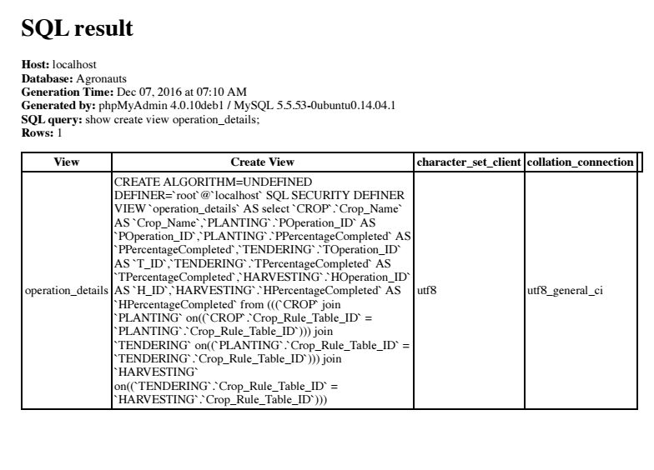
SQL VIEWS
View is the result set of a stored query on the data, which the database users can query just as they would in a persistent database collection object. This pre-established query command is kept in the database dictionary.

Slide 12
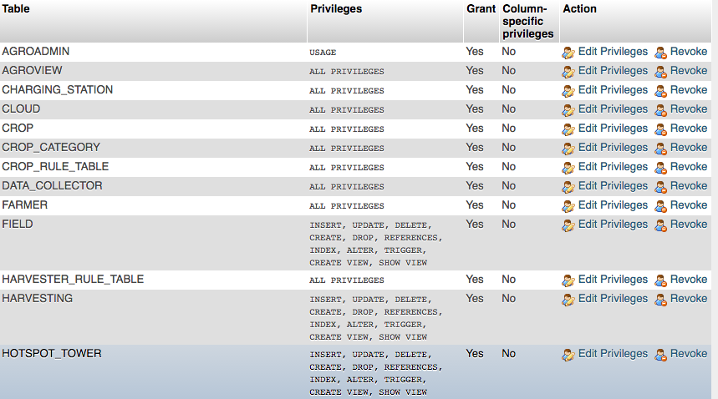
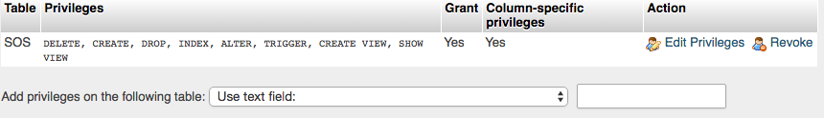
PRIVILEGES
ADMIN PRIVILEGES
FARMER PRIVILEGES

Slide 13
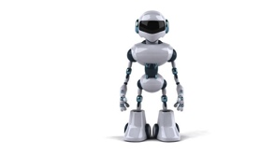
BACKUP
We do a Incremental Backup on a daily basis at 2300 hours.
Full Back up is done every week on Saturday at 2300 hours.
Full Back Up
Incremental Back Up

Slide 14
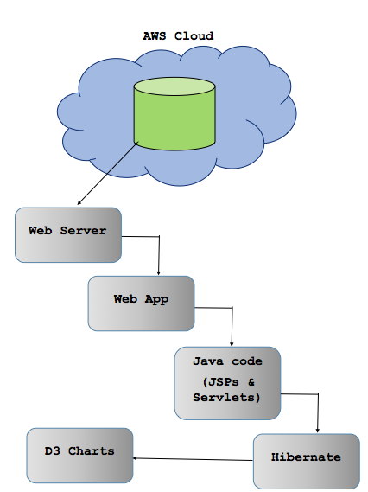
ARCHITECTURE

Slide 15
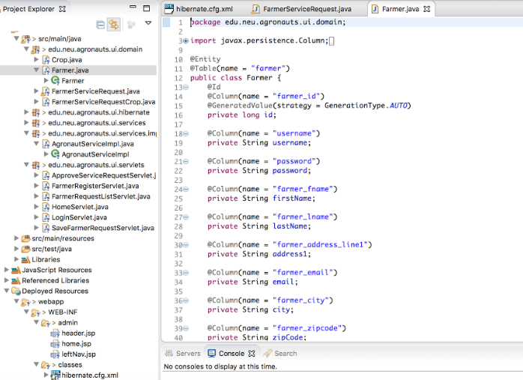
ARCHITECTURE(CODE)

Slide 16
DB STATS
TABLES
33
ATTRIBUTES
220
FULL BACKUPS ONCE/WEEK
SUBQUERIES
12
JOINS
15
INCREMENTAL
BACKUPS EVERYDAY
TRIGGERS
7
VIEWS
4
SUBQUERIES
12
STORED PROCEDURE
2

Slide 17







TOOLS USED
MySQL
Code Sharing
Java Application Development
Front End/UI Design
Cloud Computing
Presentation
File Hosting/Sharing

Slide 18
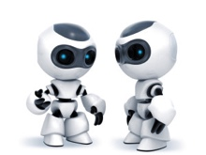
FEATURES IMPLEMENTED
Technical Implementations
Triggers
Stored Procedure
Views
Joins
Back Up
Privileges
Tables
D3 Charts
Normalized Tables
Hibernate, Servlets, JSP
AWS
Incremental backup
Dynamic Visualizations
Notes:
-add implementations

Slide 19
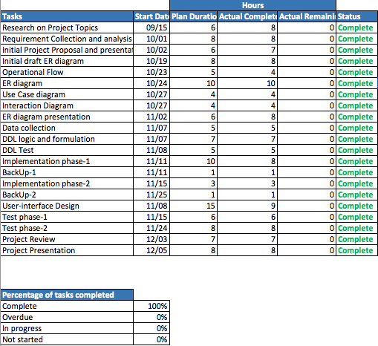
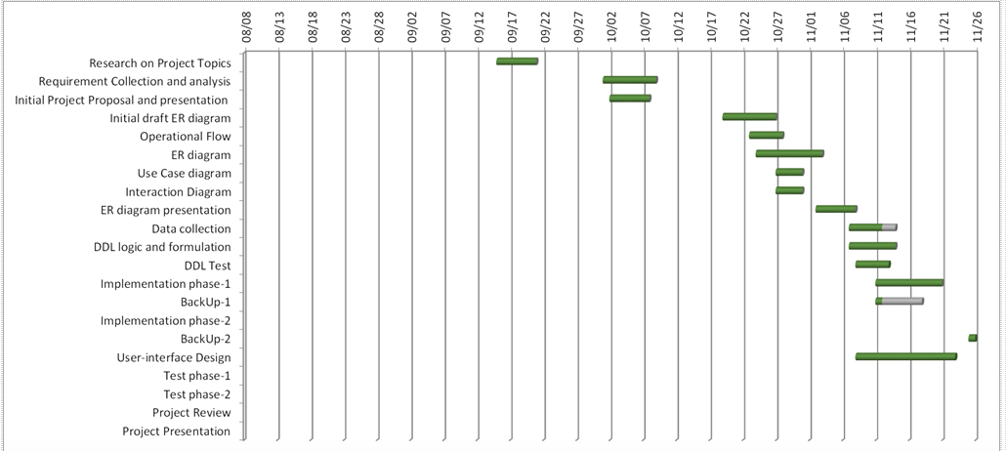
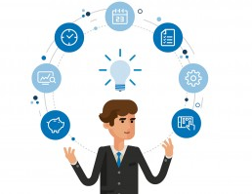
PROJECT MANAGEMENT
Dashboard
Gantt Chart

Slide 20
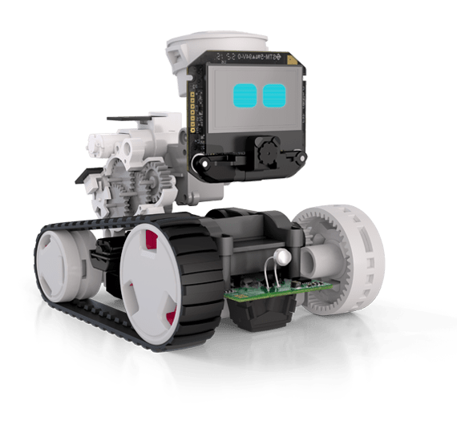
FUTURE EXPANSION
Satellite-imagery and advanced soil sensors to optimize returns on inputs while preserving resources
High-resolution crop sensors to inform application equipment of correct amounts of fertilizers needed
Optical sensors or drones that identify crop health across the field
It can be applied to multiple fields of the same farmer.

Slide 21
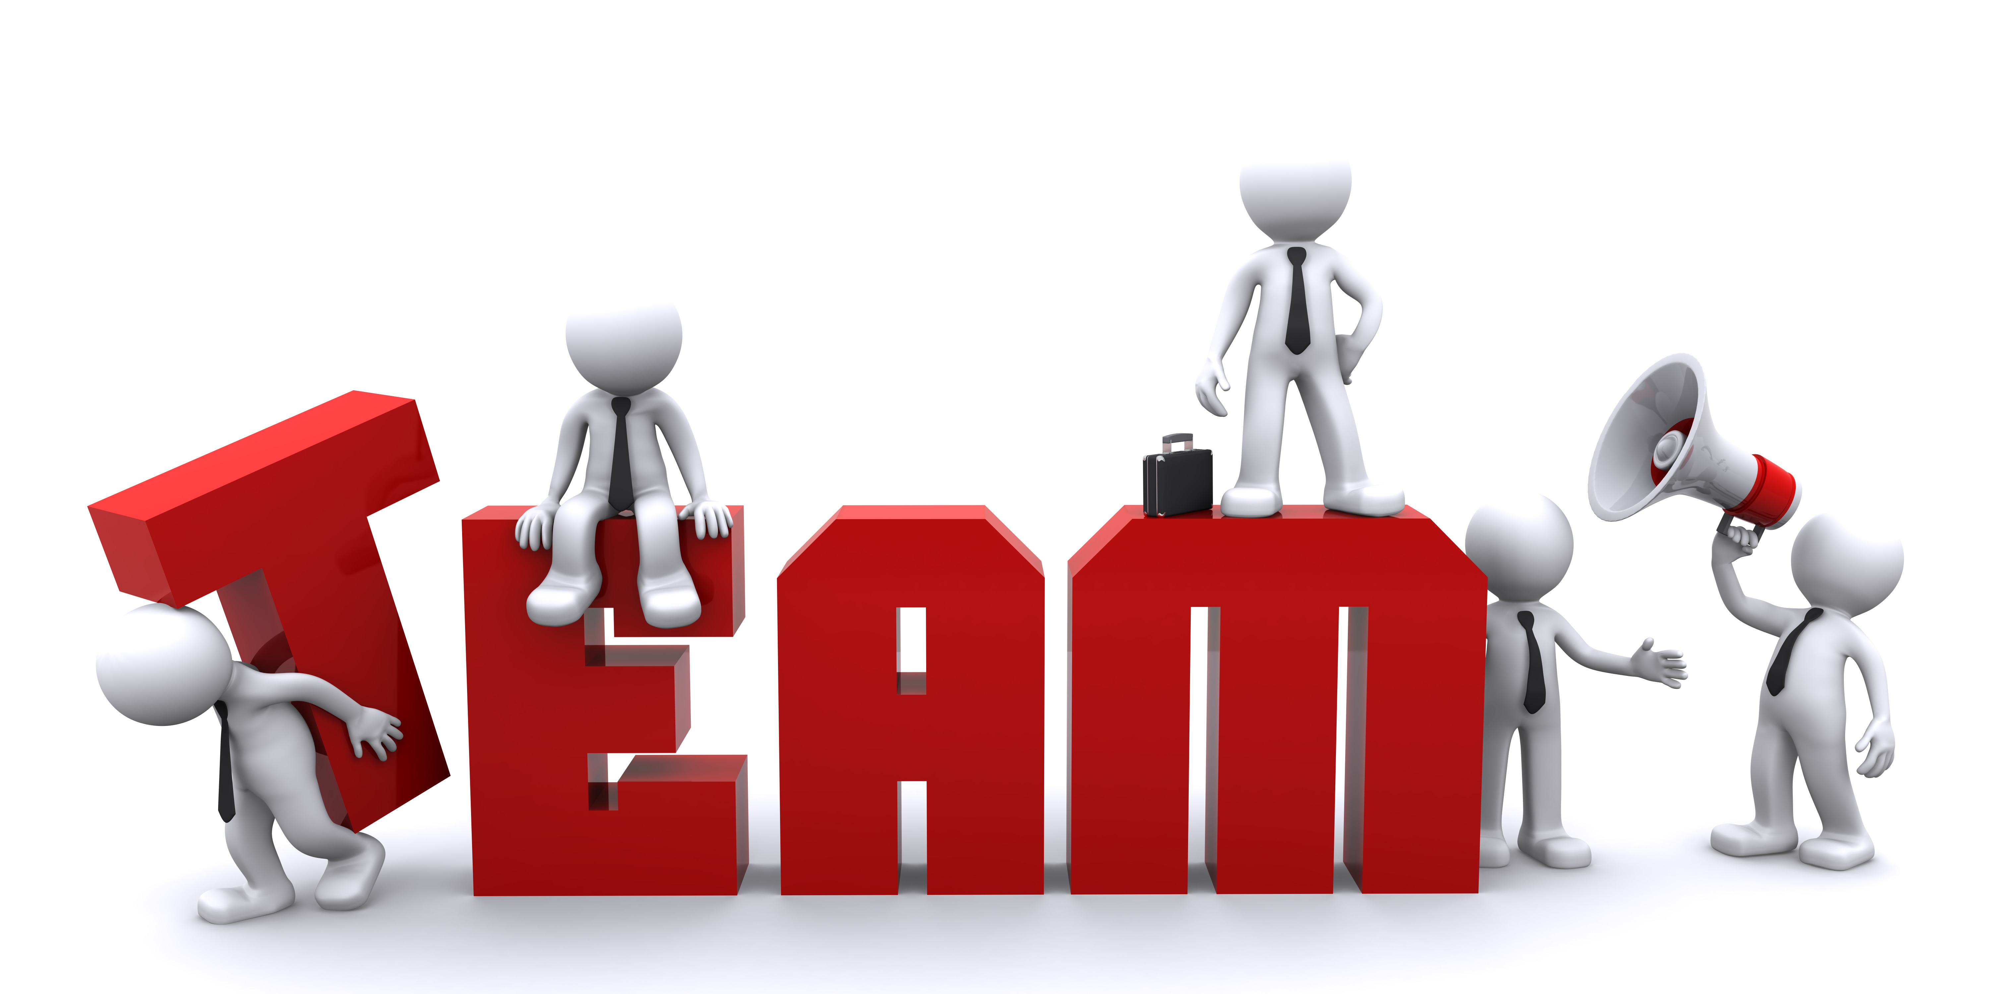
Shramika Jadhav
UI Expert
Rutika Ranjolkar
Java Expert & UI
Nitin Bali
Project Manager
Ramyasri Gujjari
DB Implementation
Vikas Sirwal
Domain Expert

